Slide 1
SQL Fundamentals in Three Hours
SQL SATURDAY - NASHVILLE
John Deardurff
Website: ThatAwesomeTrainer.com
Twitter: @John_Deardurff
Email: John@Deardurff.com

Slide 2
SQL Statement Categories
DML (Manipulation) | DCL (Control) | DDL (Definition) | TCL (Transactional)
INSERT | GRANT | CREATE | BEGIN
UPDATE | DENY | ALTER | COMMIT
DELETE | REVOKE | DROP | ROLLBACK
SELECT (DQL) |  | TRUNCATE | SAVE

Slide 3
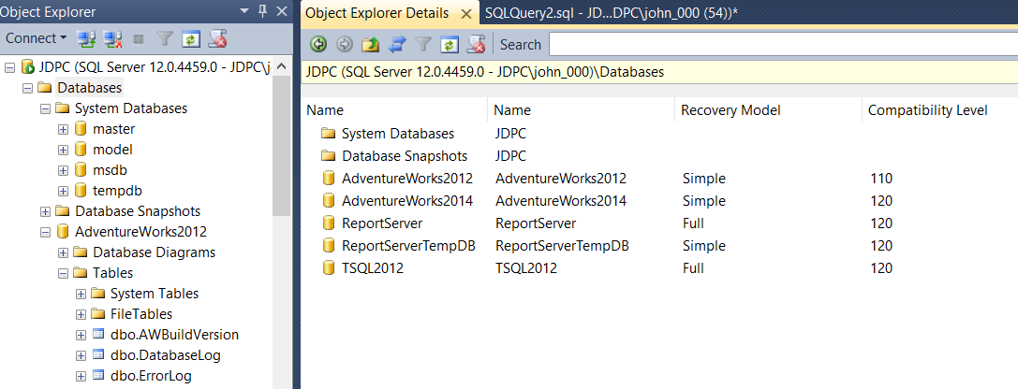
SQL Server Management Studio
System databases
User Defined databases

Slide 4
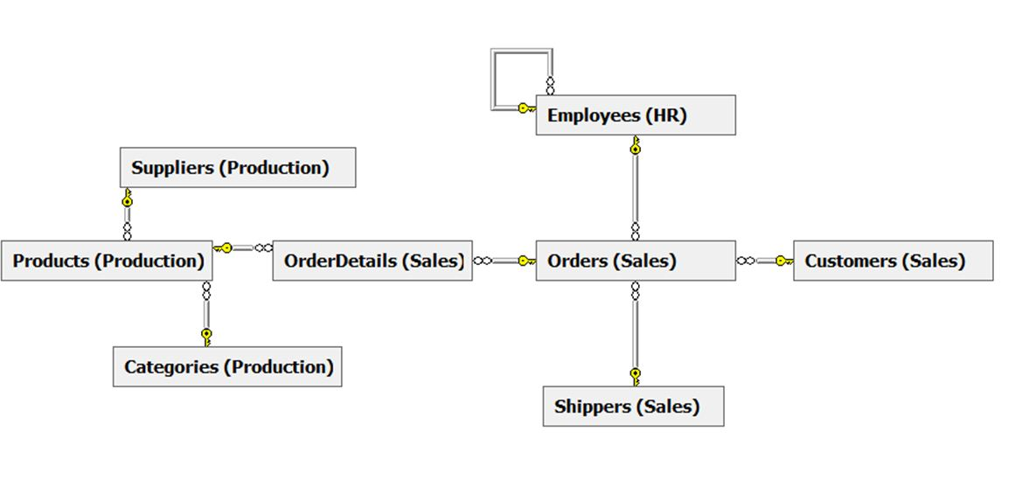
TSQL2012 Database used in this course.

Slide 5
Logical Query Processing
The order in which a query is written is not the order in which it is processed.
Order | Element | Expression | Role
5 | SELECT | <select list> | Defines which columns to return
1 | FROM | <table source> | Defines table(s) to query
2 | WHERE | <search condition> | Filters rows using a predicate
3 | GROUP BY | <group by list> | Arranges rows by groups
4 | HAVING | <search condition> | Filters groups using a predicate
6 | ORDER BY | <order by list> | Sorts the output
Notes:
Note that for the purposes of this discussion, TOP, DISTINCT and OVER are omitted.
This is a build slide - be sure to review this slide and its animation before presenting it.

Slide 6
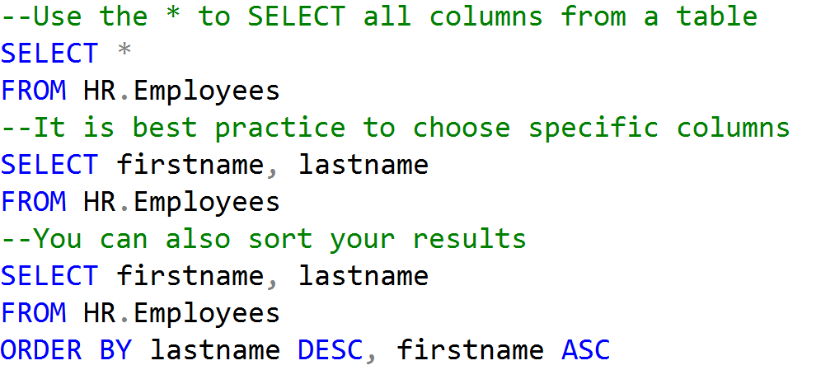
Using the SELECT statement

Slide 7
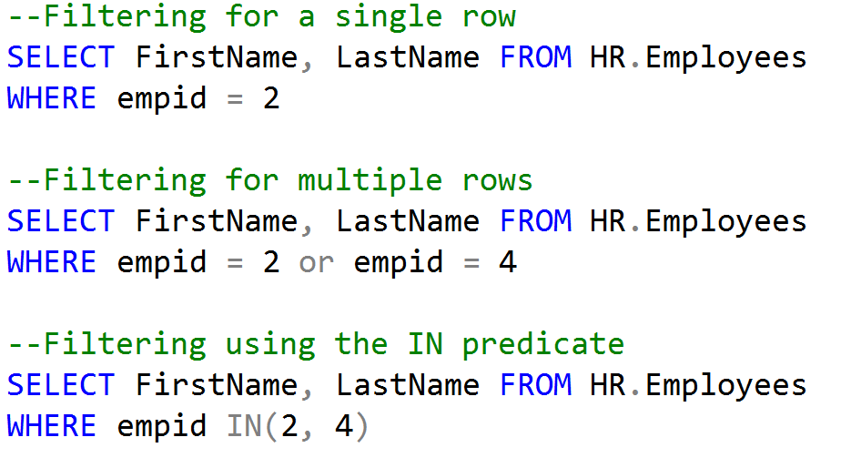
Filtering Records with the WHERE statement

Slide 8
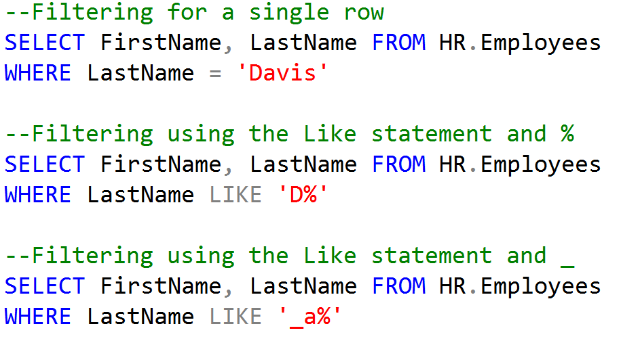
Filtering Records with the WHERE statement

Slide 9
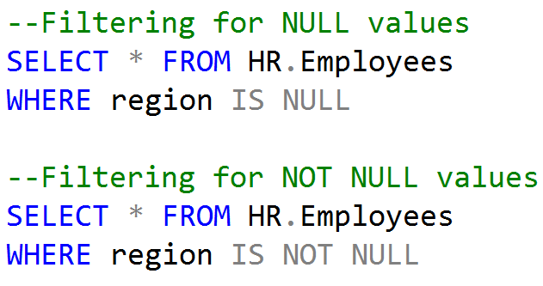
Filtering Records with the WHERE statement

Slide 10
Four Part Name
SQL Server Instance
Server-level objects
Database
Database
Database-level objects
Database-level objects
Schema
Schema
Schema
Schema
Objects
Objects
Objects
Objects

Slide 11
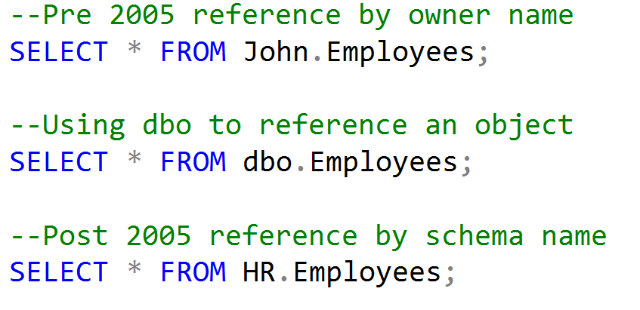
Four Part Name

Slide 12
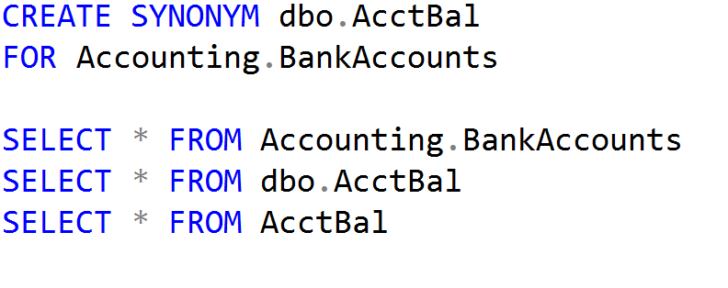
Creating a Synonym

Slide 13
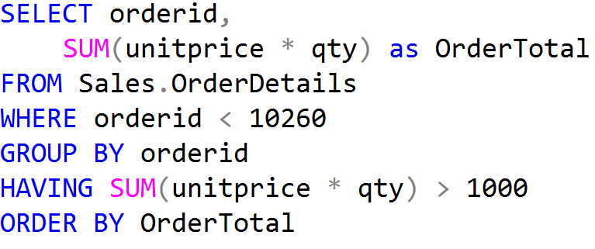
Aggregate Functions and Group By Examples
Aggregate Functions
Group By and Having

Slide 14
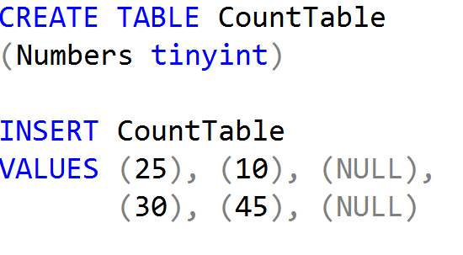
Using Aggregate Functions with NULL values

Slide 15
SET Operators
UNION returns results from both sets without duplicates
UNION ALL returns results from both sets with duplicates
INTERSECT only returns results that appear in both sets
EXCEPT returns rows from first set unless it is in second set

Slide 16
Join Types
Customers
Orders
Parent
Table
Child
Table
Left Outer
All Customers
& related Orders
Inner
Customers who placed Orders
Right Outer
All Orders
& related Customers

Slide 17
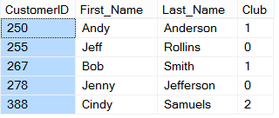
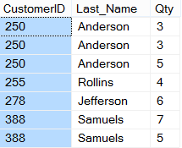
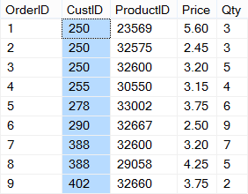
Inner Joins
CUSTOMERS
ORDERS

Slide 18
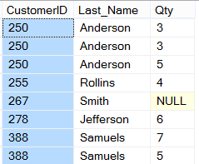
Left Outer Joins
CUSTOMERS
ORDERS

Slide 19
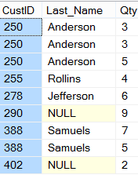
Right Outer Joins
CUSTOMERS
ORDERS

Slide 20
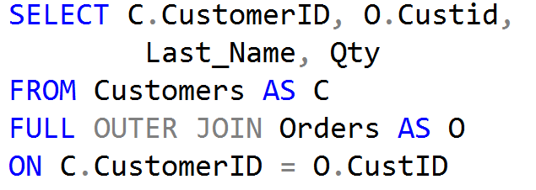
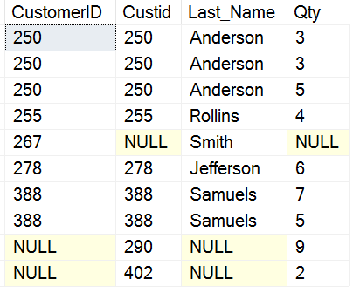
Full Outer Joins
CUSTOMERS
ORDERS

Slide 21
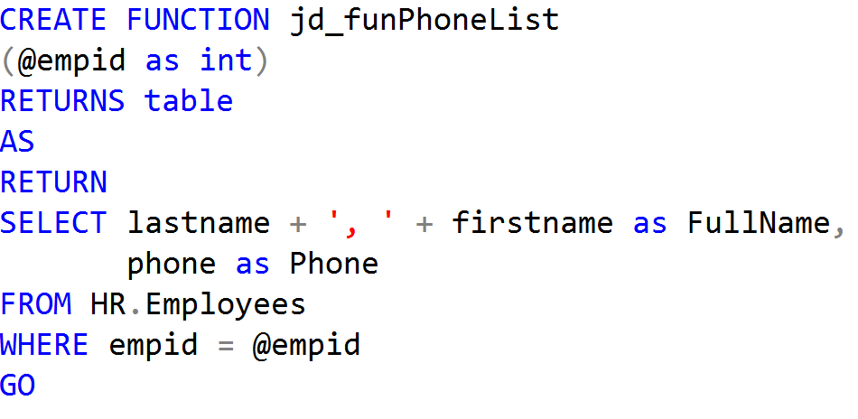
Creating Views and Table-Valued Functions
User-Defined View
Table-Valued Function

