Slide 1
A Beginners Guide to Transactions
SQL Saturday - Chicago
John Deardurff
Website: ThatAwesomeTrainer.com
Twitter: @John_Deardurff
Email: John@Deardurff.com
March 23, 2019

Slide 2
What does this session cover?
What are Transactions?
Auto-Commit vs Explicit Transactions.
ACID properties of Transactions.
How Data is Modified in SQL Server.
Working with Transactions.
Demonstration
What are Locks?

Slide 3
What is a Transaction?
A transaction is a series of one or more statements that need to operate as a single logical unit of work.
To qualify as a transaction, the logical unit of work must possess all four of the ACID properties.

Slide 4
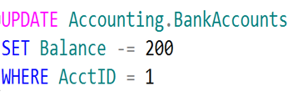
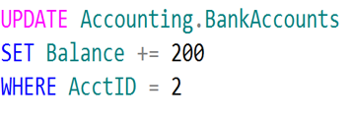
Logical Units of Work – Auto Commit Transactions
$200
John
Jane
Transaction 1
Transaction 2

Slide 5
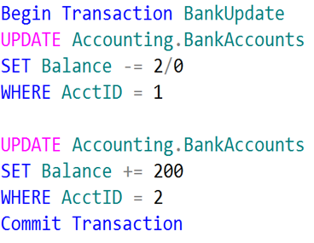
Single Logical Unit of Work – Explicit Transactions
John
Jane
Transaction 1
$200

Slide 6
Transactions must pass the ACID test
Atomicity – All or Nothing
Consistent – Only valid data
Isolated – No interference
Durable – Data is recoverable

Slide 7
How Data Is Modified in SQL Server
3. Modification is written to transaction log.
3
1. Data modification is sent to buffer cache in memory.
1
4. Checkpoint looks for committed transactions.
4
2. Data pages are located or read into the buffer cache and then modified.
2
Data Page
5. Writes modified data pages to the database file.
Data Row
Data Row
5
Data Row
Free Space
Notes:
Provide an overview of how the data is stored on SQL Server. Describe each of the three data file types and the basic internal layout of the data files. Stress that the file extension .mdf is not mandatory to use but is highly recommended.
Describe the difference between uniform and mixed extents. Note that continued support for mixed extents adds complexity to the database engine for no real benefit. The size of an extent (64 KB) is so small that the original benefit from the mixed extent design is now irrelevant.
Briefly explain that all transactions are written to the log file using the WAL mechanism to ensure the integrity of the database in case of a failure and to support rollbacks of transactions. Explain that data changes occur in the buffer pool and are not written immediately to the data files.
Avoid discussing filegroups at this point, as they will be covered later.
20462C
3: Working with Databases and Storage

Slide 8
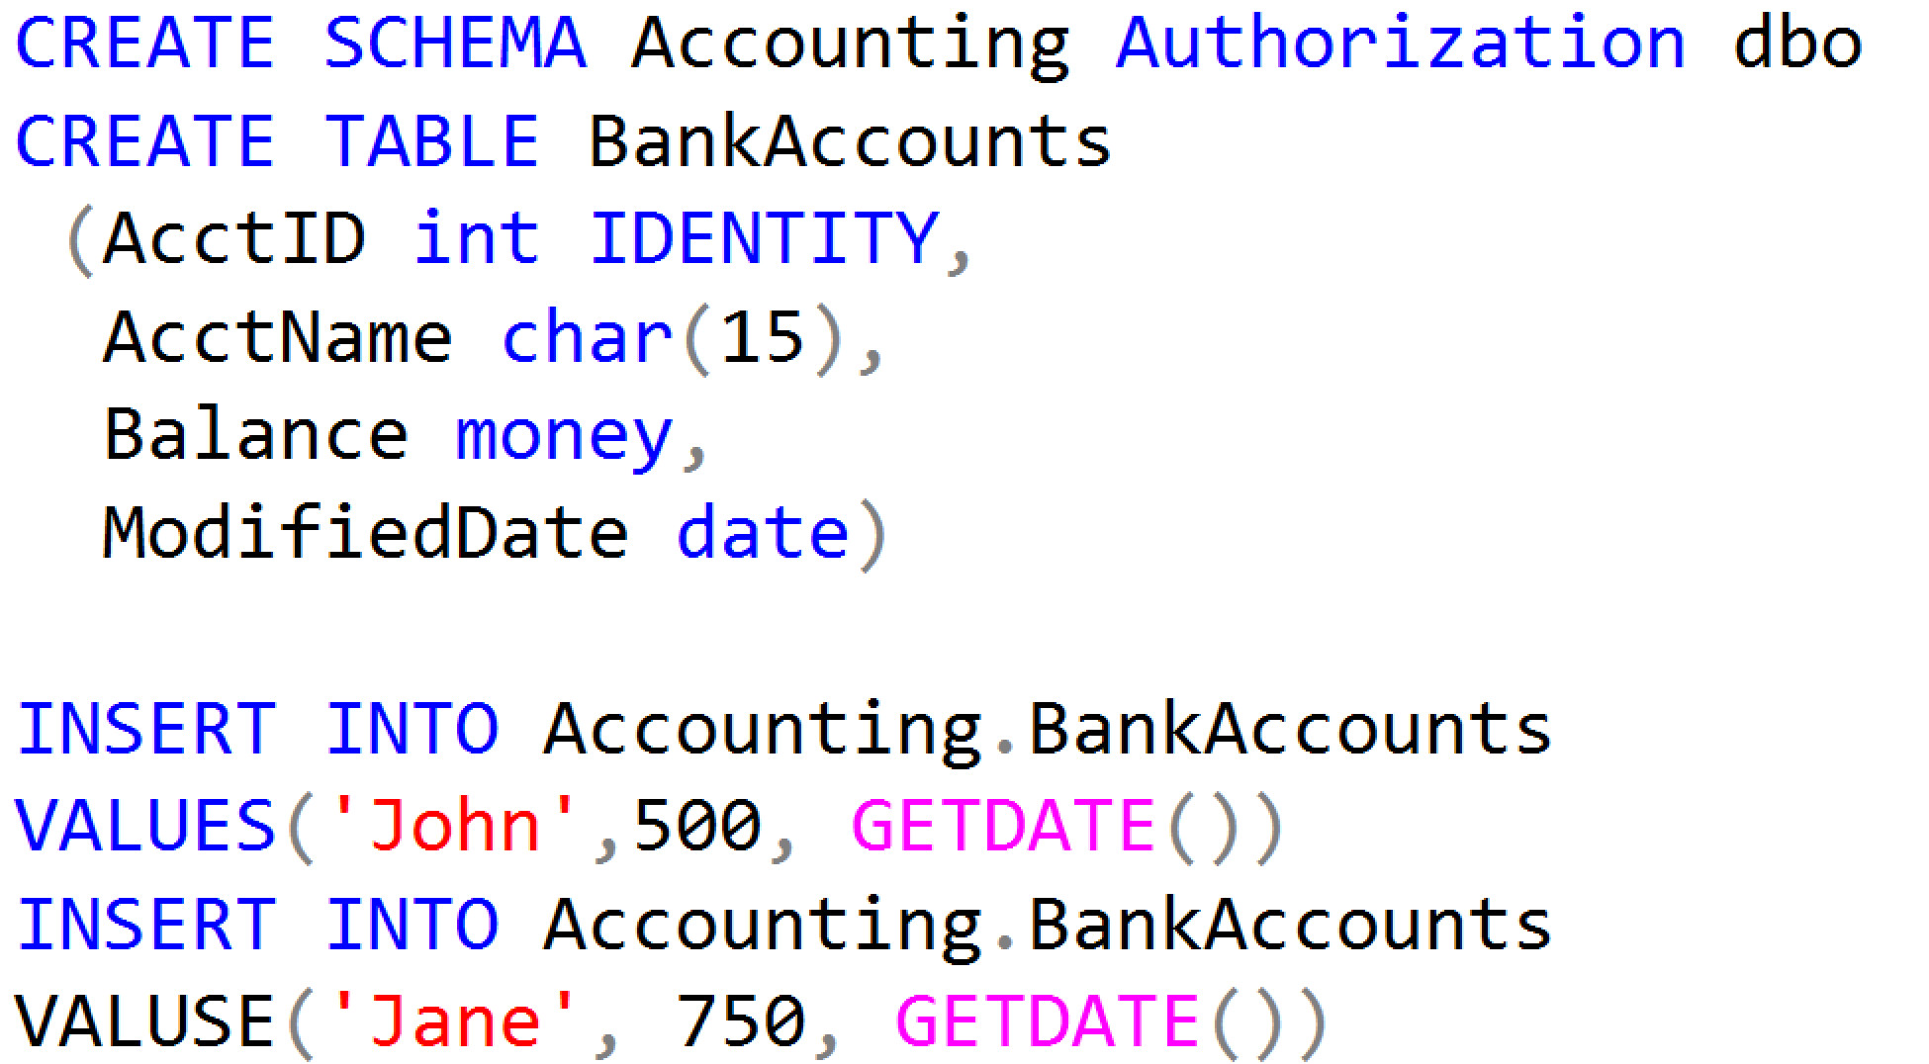
Working with Transactions

Slide 9
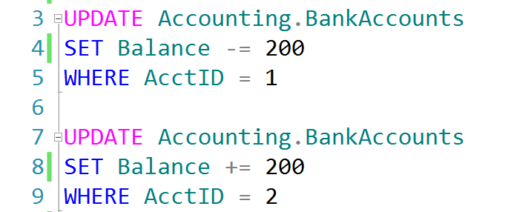
Auto-Commit Transactions without Error Handling
AdventureWorks.ldf
Checkpoint
AdventureWorks.mdf
John, don’t forget to demonstrate
SET XACT_ABORT ON

Slide 10
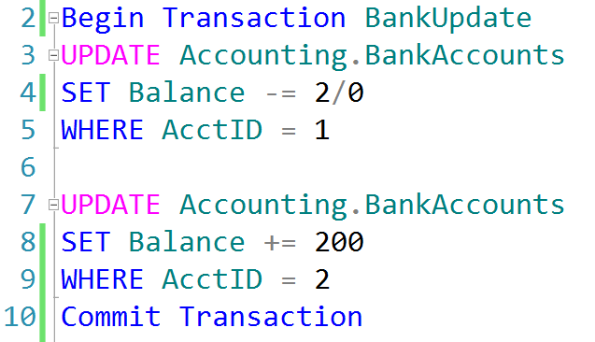
Explicit Transactions without Error Handling
AdventureWorks.ldf
Checkpoint
AdventureWorks.mdf

Slide 11
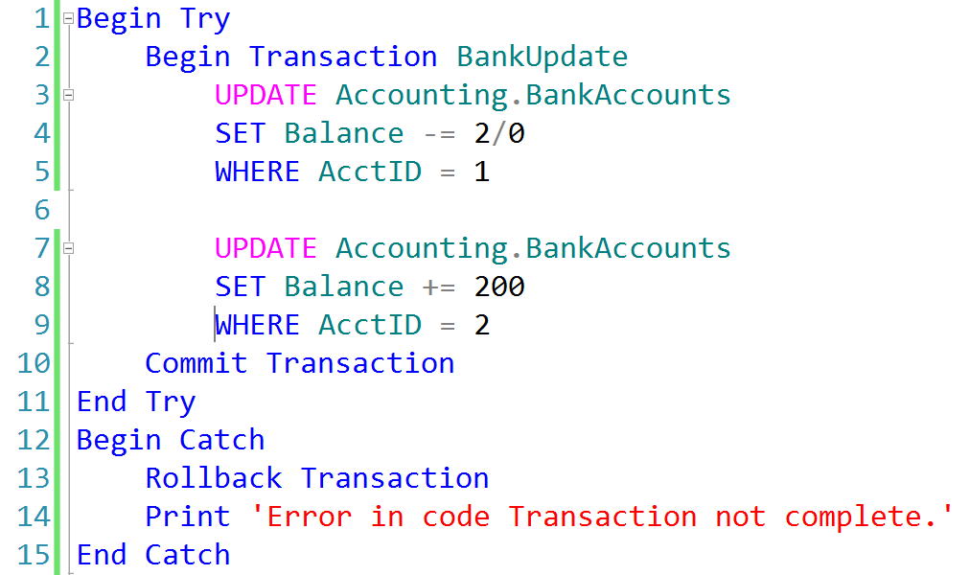
Explicit Transactions with Error Handling
AdventureWorks.ldf
AdventureWorks.mdf
Checkpoint

Slide 12
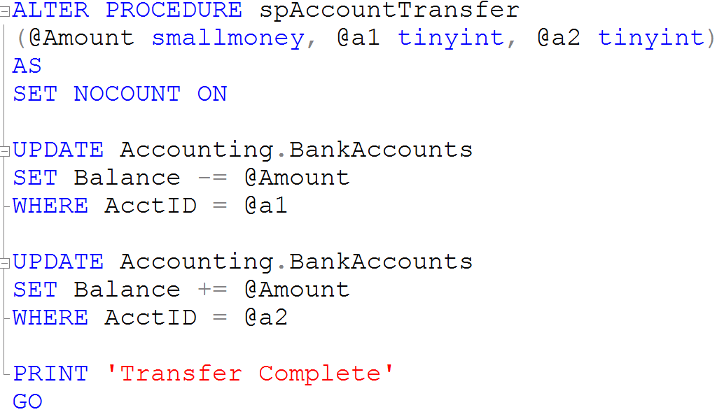
Creating Stored Procedures

Slide 13
What is a Lock?
Transaction 1
Transaction 2
TSQL2012.mdf

Slide 14
QUESTIONS

